Slide 1
Sprite & DirectInput programming

Slide 2
Objectives
Create animated objects
Access keyboard with DirectInput

Slide 3
References
Beginning Game Programming
  Chapter 7, 8 - 10

Slide 4
Sprite programming

Slide 5
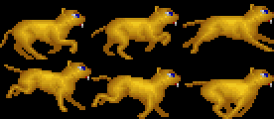
What is sprite?
A sprite is a two-dimensional image or animation that is integrated into a larger scene. (Wikipedia)

Slide 6
Surface for background
Init
  D3DXGetImageInfoFromFile
  CreateOffscreenPlainSurface
  D3DXLoadSurfaceFromFile
Render
  D3DDEVICE9::StretchRect
Notes:
- Init : LPDIRECT3DSURFACE9 CreateSurfaceFromFile(LPDIRECT3DDEVICE9 d3ddv, LPWSTR FilePath) in sample03/utils.cpp

Slide 7
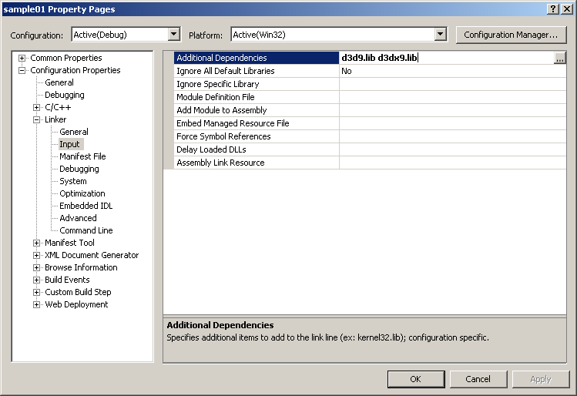
D3C Helper library (D3DX)
#include <d3dx9.h>

Slide 8
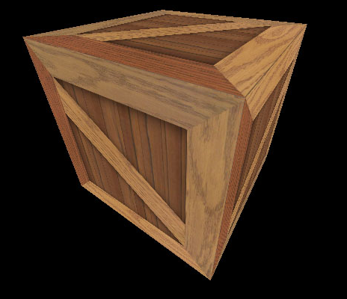
What is texture?
An image that “covers” the surface of polygons of a 3D model to make it looks more real.

Slide 9
Transparent sprite
Init
  D3DXCreateSprite: to create handler
  D3DXGetImageInfoFromFile: to get width, height
  D3DXCreateTextureFromFileEx
Render
  LPD3DXSPRITE::Begin
  LPD3DXSPRITE::Draw
  LPD3DXSPRITE::End
Notes:
D3DXCreateSprite(d3ddv,&_SpriteHandler); is called in void CKitty::LoadResources(LPDIRECT3DDEVICE9 d3ddv) in sample03/kitty.cpp
D3DXGetImageInfoFromFile(FilePath,&info); and D3DXCreateTextureFromFileEx(…) are called in CSprite::CSprite(LPD3DXSPRITE SpriteHandler, LPWSTR FilePath, int Width, int Height, int Count, int SpritePerRow) in sample03/sprite.cpp
In computer graphics, a sprite is a two-dimensional bitmap that is integrated into a larger scene.
Originally sprites referred to independent objects that are composited together, by hardware, with other elements such as a background.^{[1]} This occurs as each scan line is prepared for the video output device, such as a CRT
Use of the term "sprite" has expanded to refer to any two-dimensional bitmap used as part of a graphics display, even if drawn into a frame buffer (by either software or a GPU) instead of being composited on-the-fly at display time.
Sprite là các bitmap 2d đươc intergrate với nhau thành một cảnh lớn
Ban đầu, sprites được dung để chỉ các đối tượng độc lập được gắn lại với nhau, bằng phần cứng, cùng với các thành phần khác như background. Sprites được dùng trong ngữ cảnh khi các scan line (từng dòng quét trong chế độ raster scanning – quét toàn bộ image bằng cách quét tuần tự từng dòng trong image đó) được chuẩn bị cho các thiết bị đầu ra video
Sau này khái niệm sprites được mở rộng, có thể dùng cho cả các hình được vẽ vào framebuffer (khi xưa chỉ dược dùng cho các bitmap trong thời điểm display – hiển thị)
WIKI FULL:
In computer graphics, a sprite is a two-dimensional bitmap that is integrated into a larger scene.
Originally sprites referred to independent objects that are composited together, by hardware, with other elements such as a background.^{[1]} This occurs as each scan line is prepared for the video output device, such as a CRT, without involvement of the main CPU and without the need for a full-screen frame buffer.^{[1]} Sprites can be positioned or altered by setting attributes used during the hardware composition process. Examples of systems with hardware sprites include the Atari 8-bit family, Commodore 64, Nintendo Entertainment System, Sega Genesis, and many coin-operated arcade machines of the 1980s.
Use of the term "sprite" has expanded to refer to any two-dimensional bitmap used as part of a graphics display, even if drawn into a frame buffer (by either software or a GPU) instead of being composited on-the-fly at display time.

Slide 10
A sprite class
To handle sprites within a large bitmap

Slide 11
A sprite class - Definition
class Sprite {
protected:
LPDIRECT3DTEXTURE9 _Image; // The “container”
LPD3DXSPRITE _SpriteHandler;
int _Index; // Current sprite index
int _Width; // Sprite width
int _Height; // Sprite height
int _Count; // Number of sprites in the container
int _SpritePerRow; // Number of sprites per row
public:
Sprite::Sprite(LPD3DXSPRITE SpriteHandler, char *Path, int Width, int Height, int Count, int SpritePerRow);
// Advance to next sprite in the list
void Next();
// Render current sprite at location (X,Y) at the target surface
void Render(LPDIRECT3DSURFACE9 Target, int X, int Y);
~Sprite();
};

Slide 12
A sprite class
_SpritePerRow = 3
_Width
_Height
_Count = 6

Slide 13
A sprite class - Constructor
Sprite::Sprite(
LPD3DXSPRITE SpriteHandler, char *Path, int Width, int Height,
int Count, int SpritePerRow) {
D3DXIMAGE_INFO info;
HRESULT result;
_Image = NULL;
_SpriteHandler = SpriteHandler;
_Width = Width;
_Height = Height;
_Count = Count;
_SpritePerRow = SpritePerRow;
_Index = 0;
result = D3DXGetImageInfoFromFile(Path,&info);
//result = d3ddv->CreateOffscreenPlainSurface(
// info.Width,
// info.Height,
// D3DFMT_X8R8G8B8,
// D3DPOOL_DEFAULT,
// &_Surface,
// NULL);
//if (result!=D3D_OK)
//{
// int i = 10;
//}
//result =
// D3DXLoadSurfaceFromFile(
// _Surface,
// NULL,
// NULL,
// Path,
// NULL,
// D3DX_DEFAULT,
// D3DCOLOR_XRGB(0,0,0), // black is the transparent color
// NULL);
LPDIRECT3DDEVICE9 d3ddv;
SpriteHandler->GetDevice(&d3ddv);
D3DXCreateTextureFromFileEx(
d3ddv,
Path,
info.Width,
info.Height,
1,
D3DUSAGE_DYNAMIC,
D3DFMT_UNKNOWN,
D3DPOOL_DEFAULT,
D3DX_DEFAULT,
D3DX_DEFAULT,
D3DCOLOR_XRGB(0,0,0),
&info,
NULL,
&_Image);
if (result!=D3D_OK)
{
int i = 10;
}
}

Slide 14
A sprite class – Constructor (Cont.)
Sprite::Sprite(...)
...
result = D3DXGetImageInfoFromFile(Path,&info);
...
LPDIRECT3DDEVICE9 d3ddv; SpriteHandler->GetDevice(&d3ddv);
result = D3DXCreateTextureFromFileEx(
d3ddv, Path,
info.Width, info.Height,
1, //Mipmap levels
D3DUSAGE_DYNAMIC,
D3DFMT_UNKNOWN,
D3DPOOL_DEFAULT,
D3DX_DEFAULT,
D3DX_DEFAULT,
D3DCOLOR_XRGB(0,0,0), // Transparent color
&info, // Image information
NULL,
&_Image); // Result
...

Slide 15
A sprite class – Render Method
void Sprite::Render(LPDIRECT3DSURFACE9 Target, int X, int Y) {
RECT srect;
srect.left = (_Index % _SpritePerRow)*(_Width);
srect.top = (_Index / _SpritePerRow)*(_Height);
srect.right = srect.left + _Width - 1;
srect.bottom = srect.top + _Height - 1;
_SpriteHandler->Begin(D3DXSPRITE_ALPHABLEND);
D3DXVECTOR3 position((float)X,(float)Y,0);
_SpriteHandler->Draw(
_Image,
&srect,
NULL,
&position,
D3DCOLOR_XRGB(255,255,255) // Hardcode!
);
_SpriteHandler->End();
}
Not a good idea if there are many sprites to draw
Notes:
- Solution: Compose all the spites (Dennis, David, Kitty etc… into one file) ????

Slide 16
A sprite class
(0,_Width-1)
(0,_Width)
(0,2*_Width)
(0,0)

Slide 17
Main program
Sprite *Kitty = NULL;
int GameInit(HWND hWnd) {
d3d = Direct3DCreate9(D3D_SDK_VERSION);
d3d->CreateDevice(...);
d3ddv->GetBackBuffer(...,&back_buffer);
...
D3DXCreateSprite(d3ddv,&sprite_handler);
Kitty = new Sprite(sprite_handler, "kitty.bmp", 92, 60, 6, 3);
return 1;
}

Slide 18
Main program
void GameRun(HWND hWnd) {
...
if (d3ddv->BeginScene()) {
d3ddv->ColorFill(back_buffer,NULL,D3DCOLOR_XRGB(255,0,0));
Kitty->Render(back_buffer,_left, 100);
Kitty->Next();
_left=(_left+10) % SCREEN_WIDTH;
d3ddv->EndScene();
}
d3ddv->Present(NULL,NULL,NULL,NULL);
...
}

Slide 19
DirectInput Programming

Slide 20

DirectInput Programming
#include <Dinput.h>

Slide 21
Keyboard
DirectInput8Create
LPDIRECTINPUT8::CreateDevice
  GUID_SysKeyboard
LPDIRECTINPUTDEVICE::SetDataFormat
  c_dfDIKeyboard
LPDIRECTINPUTDEVICE::Acquire
GetDeviceState
LPDIRECTINPUTDEVICE::Unacquire
Notes:
GUID_SysKeyboard , c_dfDIKeyboard: parameters
LPDIRECTINPUTDEVICE::Acquire should be called in InItKeyBoard

Slide 22
Keyboard
int InitKeyboard(HINSTANCE hInstance, HWND hWnd) {
HRESULT result;
result = DirectInput8Create(hInstance, DIRECTINPUT_VERSION, IID_IDirectInput8, (void**)&dinput, NULL);
if (result!=DI_OK)
return 0;
result = dinput->CreateDevice(GUID_SysKeyboard, &didev, NULL);
...
result = didev->SetDataFormat(&c_dfDIKeyboard);
result = didev->SetCooperativeLevel(hWnd, DISCL_FOREGROUND | DISCL_NONEXCLUSIVE);
result = didev->Acquire();
return 1;
}
Notes:
c_dfDIKeyboard: use extern const DIDATAFORMAT c_dfDIKeyboard; instead of c_dfDIMouse / c_dfDIMouse2 /c_dfDIJoystick / c_dfDIJoystick2 (Define int dinput.h)

Slide 23
Keyboard
#define KEYDOWN(name, key) (name[key] & 0x80)
...
char keys[256];
didev->GetDeviceState(sizeof(keys),&keys);
if (KEYDOWN(keys, DIK_ESCAPE))
PostMessage(hWnd,WM_DESTROY,0,0);
if (KEYDOWN(keys, DIK_HOME))
...
Where to find all the keyboard constants?
DirectX Input/Direct Input/Reference/Device Constants
Notes:
Where to find all the keyboard constants? ➔ dinput.h / DirectInput keyboard scan codes
DIK_ESCAPE: DirectInput Keyboard

Slide 24
Buffered input
// Initialize
// The buffer size is a DWORD property associated with the device.
DIPROPDWORD dipdw;
dipdw.diph.dwSize = sizeof(DIPROPDWORD);
dipdw.diph.dwHeaderSize = sizeof(DIPROPHEADER);
dipdw.diph.dwObj = 0;
dipdw.diph.dwHow = DIPH_DEVICE;
dipdw.dwData = KEYBOARD_BUFFER_SIZE;
_Keyboard->SetProperty( DIPROP_BUFFERSIZE, &dipdw.diph );
Notes:
The Input buffer is also commonly known as the input area or input block.
When referring to computer memory, the input buffer is a location that holds all incoming information before it continues to the CPU for processing.
Input buffer can be also used to describe other hardware or software buffers used to STORE INFORMATION before it is processed.

Slide 25
Buffered input
// Handle key press event
// NOTES: Buffered input is like an Event
// Get all events (also clear them from DirectInput buffer)
DWORD dwElements = KEYBOARD_BUFFER_SIZE;
HRESULT hr = _Keyboard->GetDeviceData( sizeof(DIDEVICEOBJECTDATA), _KeyEvents, &dwElements, 0 );
// Scan through all data, check if the key is pressed or released
for( DWORD i = 0; i < dwElements; i++ )
{
int KeyCode = _KeyEvents[i].dwOfs;
int KeyState = _KeyEvents[i].dwData;
if ( (KeyState & 0x80) > 0)
//Process key DOWN event
else
//Process key UP event
}
Notes:
_KeyEvents : save all the Key Events into this array
dwElements : number of events saved

Slide 26
Mouse
DirectInput8Create
LPDIRECTINPUT8::CreateDevice
  GUID_SysMouse
LPDIRECTINPUTDEVICE::SetDataFormat
  c_dfDIMouse
LPDIRECTINPUTDEVICE::Acquire
GetDeviceState
LPDIRECTINPUTDEVICE::Unacquire

Slide 27
Mouse
...
DIMOUSESTATE mouse_state;
dev_mouse->GetDeviceState(sizeof(mouse_state),&mouse_state);
struct DIMOUSESTATE {
LONG lX; // distance movement of X
LONG lY; // distance movement of Y
LONG lZ; // distance movement of mouse wheel
BYTE rgbButtons[4]; // mouse button state
};
How do I know the CURRENT cursor position?

Slide 28
Battle City project

Slide 29
Game play
Objectives: Protect head-quarter while trying to destroy all enemy tanks
One player or two players coopertative
Enemy tanks:
  Light tank: normal, one-shot kill
  Quick tank: fast, one-shot kill
  Heavy tank: slow, 4 shots kill
Power up
  Appear at random location when hitting red flashing tanks, if not picked up, power up disappears after a short-period of time (flashing indicates power up is going to disappear)
  Star: upgrade player’s tank (1: slow bullet-1 bullet at a time, 2: faster bullet, 3: 2 bullets at a time; 4: concret destroy bullets) – additional star give extra life
  Grenade: destroy all enemy tanks on screen
  Helmet: invulnerability within a short-period of time
  Timer: stop all enemy tanks
  Shovel: turn headquarter walls into concretes for a short-period of time

Slide 30
Game play
Terrain types
  Clear: passable
  Tree: passable but object barely visible
  Snow: passable but slippery
  Water: not passable, not destroyable, bullet passable
Blocking objects
  Wall: destroyed by normal bullets (player & enemy tanks)
  Concrete: only be destroyed by level-4 player tank bullets
Others
  Tanks (both player’s or enemy tank) block each other
  Bullet of enemy tanks and player tank destroy each other when collide
  Head-quarter destroyed if hit by any bullet (from player’s tank or enemy tank)
  Enemy tanks appear at fixed location on map (mark by a star)

Slide 31
Problems to solve
Collision: tank – tank; tank – terrain, tank bullet, bullet – wall, concrete
  Collision “map” = separate bitmap specificly used for collision detection
Enemy tank AI
  Movement (random but head-quarter oriented)
  When to shooting (random?)
Multiple level game
Level data structure?
Two players

Slide 32
Collision detection

Slide 33
Generally good but WRONG
FRAME 1
Wall
Ball

Slide 34
Generally good but WRONG
FRAME 2
Wall
GOOD NO PROBLEM ?

Slide 35
Generally good but WRONG
Correct position
Wrong new position
FRAME 2
Wall
BALL MOVE TOO FAST
COMPUTER TOO SLOW

Slide 36
RIGHT way but … you need a MATH book!
Old position

Slide 37
Some ideas about collision detection
Player expects a game world to be a continuous world
But computer can only update game world at points of time.
A true collision detection must
  Base on last “world state”
  Calculate the new “world state” if there is no collision
  Interpolate all states in-between
  Detect collision using all three above info
  Handle the collision to build a new “world state”
Notes:
Interpolate : nội suy

